Slide 1
Math 769: Statistical Learning

Slide 2
Types of Data
Shahrzad Jamshidi, PhD

Slide 3
Last Time
The central elements of a statistical learning problem are:
The data/the dataset
The model
What can be inferred? (e.g., a prediction)
We concluded with several questions.
What kinds of datasets can we use?
We cannot answer the above question without knowing what types of data are possible.

Slide 4
Objectives for this Lesson
List the 10 types of data as well as subtypes.
For each type of data, produce examples.
Describe how image data is represented in a computer.

Slide 5
Introduction
Data comes in a variety of forms and formats, each with its unique characteristics and properties.
Types of data include:
Numerical
Categorical
Time-series
Cross-sectional
Longitudinal
Panel
Geospatial
Image and Video
Audio
Text

Slide 6
Numerical Data
Numerical data consists of measurable quantities.
Examples include temperature, age, and income.
Two main types:
Discrete Data: Countable values with gaps between them; often whole numbers.
Continuous Data: Values that can be any real number within a range.

Slide 7
Numerical Dataset Example
Name | Height (in cm) | Cars Owned
Sarah | 165.2 | 2
Yasmine | 178.5 | 1
Maria | 155.8 | 0
Rajesh | 172.0 | 3
Hikaru | 162.3 | 1

Slide 8
Numerical Dataset Example
Name | Height (in cm) | Cars Owned
Sarah | 165.2 | 2
Yasmine | 178.5 | 1
Maria | 155.8 | 0
Rajesh | 172.0 | 3
Hikaru | 162.3 | 1
Discrete Numerical Data

Slide 9
Numerical Dataset Example
Name | Height (in cm) | Cars Owned
Sarah | 165.2 | 2
Yasmine | 178.5 | 1
Maria | 155.8 | 0
Rajesh | 172.0 | 3
Hikaru | 162.3 | 1
Continuous Numerical Data

Slide 10
Remark on “Continuous” Numerical Data
You may notice that “continuous” numerical data is made discrete due to limited decimal places.
Because all numbers within a computer are discrete from this perspective, we typically refer to numerical data as “continuous” if it is represented as a floating-point number that is rounded to a specific decimal place.

Slide 11
Categorical Data
Categorical data consists of categories or labels.
Examples include gender, blood type, and types of fruit.
It can be further classified as:
Nominal categorical data meaning there is no inherent order to the categories.
Ordinal categorical data meaning the categories are ordered.

Slide 12
Categorical Dataset Example
Name | Eye Color | Education Level
Alice | Brown | Bachelor’s Degree
Jamal | Green | High School Diploma
Aisha | Blue | Master’s Degree
Ricardo | Hazel | Some College, No Degree
Thanh | Gray | Associate’s Degree

Slide 13
Categorical Data Example
Name | Eye Color | Education Level
Alice | Brown | Bachelor’s Degree
Jamal | Green | High School Diploma
Aisha | Blue | Master’s Degree
Ricardo | Hazel | Some College, No Degree
Thanh | Gray | Associate’s Degree
Nominal Categorical Data

Slide 14
Categorical Data Example
Name | Eye Color | Education Level
Alice | Brown | Bachelor’s Degree
Jamal | Green | High School Diploma
Aisha | Blue | Master’s Degree
Ricardo | Hazel | Some College, No Degree
Thanh | Gray | Associate’s Degree
Ordinal Categorical Data

Slide 15
Time Series Data
Time series data is collected or recorded at regular time intervals.
Examples include stock prices, weather data, and daily sales figures.
It is important to note that:
Temporal order is crucial.
Autocorrelation, the statistical concept that data is heavily influenced by past points, generally exists in these datasets.

Slide 16
Time Series Dataset Example
Date | Stock Price
2023-09-01 | 100.00
2023-09-02 | 101.25
2023-09-03 | 99.80
2023-09-04 | 102.10
2023-09-05 | 103.05

Slide 17
Cross-Sectional Data
Cross-sectional data is collected from multiple individuals, entities, or subjects at a single point in time.
It provides a snapshot of a population or a sample at a specific moment.
Commonly used in surveys, polls, and market research.

Slide 18
Cross-Sectional Dataset Example
Household ID | Household Income | Number of Family Members
001 | $50,000 | 3
002 | $38,000 | 1
003 | $65,000 | 4
004 | $42,500 | 3
005 | $55,200 | 2
Notes:
Suppose a government agency conducts a survey to gather information about household incomes in a particular city during the month of June 2023. The survey is administered to a randomly selected group of households, and the following data is collected

Slide 19
Longitudinal Data
Longitudinal data tracks the same subjects or entities over multiple time points.
It is useful for studying changes and trends over time.
Examples include clinical trials, educational cohort studies, and environmental studies.

Slide 20
Cross-Sectional Dataset Example
Year | Quarter | Salesperson A | Salesperson B | Salesperson C
1 | Q1 | 75 | 92 | 68
1 | Q3 | 88 | 105 | 75
2 | Q1 | 95 | 110 | 82
2 | Q3 | 110 | 125 | 90
3 | Q1 | 105 | 120 | 88
Notes:
Here's a fictional example of a longitudinal dataset tracking the quarterly sales performance of three sales representatives (Salesperson A, Salesperson B, and Salesperson C) over three years. The sales figures are in thousands of dollars.
This dataset allows for the analysis of sales performance trends over two years, including quarterly fluctuations and comparisons between salespeople.

Slide 21
Panel Data
Panel data combines cross-sectional and longitudinal data.
It involves multiple entities observed at multiple time points.
Often used in economics and social sciences for studying individual-level changes.

Slide 22
Panel Dataset Example
Year | Company | Revenue | Profit Margin | Market Share
1 | A | 100.0 | 12.5% | 15.0%
1 | B | 85.0 | 8.0% | 12.5%
2 | A | 120.0 | 14.0% | 20.0%
2 | B | 110.0 | 13.2% | 15.5%
3 | A | 90.0 | 8.5% | 12.0%
3 | B | 125.0 | 13.8% | 21.0%
Notes:
Here's a fictional example of a panel dataset tracking the performance of two companies (Company A and Company B) over three years. The dataset includes financial metrics: Revenue (in millions of dollars), Profit Margin (as a percentage), and Market Share (as a percentage).

Slide 23
Dimensionality and Panel Data
Because panel data combines longitudinal and cross-sectional data, it may be better to see it has “higher dimensional”
Previous examples are naturally presented in two-dimensional tables.
Panel data is harder to read in two dimensions, but works well in three dimensions.

Slide 24
Panel Dataset Example – “3D”
Company A
Company B
Year | Rev. | PM | MS
1 | 100.0 | 12.5% | 15.0%
2 | 120.0 | 14.0% | 20.0%
3 | 90.0 | 8.5% | 12.0%
Year | Rev. | PM | MS
1 | 85.0 | 8.0% | 12.5%
2 | 110.0 | 13.2% | 15.5%
3 | 125.0 | 13.8% | 21.0%
Notes:
We can think of this panel data as three dimensional, which each of these charts layered on top of each other.

Slide 25
Panel Dataset Example – “3D”
Company A
Company B
Year | Rev. | PM | MS
1 | 100.0 | 12.5% | 15.0%
2 | 120.0 | 14.0% | 20.0%
3 | 90.0 | 8.5% | 12.0%
Year | Rev. | PM | MS
1 | 85.0 | 8.0% | 12.5%
2 | 110.0 | 13.2% | 15.5%
3 | 125.0 | 13.8% | 21.0%
Notes:
One dimension happens over time in years.

Slide 26
Panel Dataset Example – “3D”
Company A
Company B
Year | Rev. | PM | MS
1 | 100.0 | 12.5% | 15.0%
2 | 120.0 | 14.0% | 20.0%
3 | 90.0 | 8.5% | 12.0%
Year | Rev. | PM | MS
1 | 85.0 | 8.0% | 12.5%
2 | 110.0 | 13.2% | 15.5%
3 | 125.0 | 13.8% | 21.0%
Notes:
One dimension happens across the different financial metrics.

Slide 27
Panel Dataset Example – “3D”
Company A
Company B
Year | Rev. | PM | MS
1 | 100.0 | 12.5% | 15.0%
2 | 120.0 | 14.0% | 20.0%
3 | 90.0 | 8.5% | 12.0%
Year | Rev. | PM | MS
1 | 85.0 | 8.0% | 12.5%
2 | 110.0 | 13.2% | 15.5%
3 | 125.0 | 13.8% | 21.0%
Notes:
And the third dimension happens across the different companies.
In several learning problems, it may make sense to organize data not in two dimensional tables (like a matrix), but in three-dimensional tables (like a tensor). We will talk about this more later on in the course.

Slide 28
Binary Data
Binary data has only two possible values, typically 0 and 1.
Examples include yes/no responses, presence/absence indicators, and success/failure outcomes.

Slide 29
Binary Dataset Example
Email Recipient | Link opened? | Purchase made?
aliya.wilson@example.com | 0 | 0
rahul.patel@hotmail.com | 1 | 0
mohammed.kim@gmail.com | 1 | 1
elena.sanchez@outlook.com | 0 | 0
ivan.chen@yahoo.com | 1 | 0
Notes:
Here's a fictional example of a binary dataset that represents whether customers made a purchase (1 for "Yes" and 0 for "No") for an online store's promotional campaign

Slide 30
Geospatial Data
Geospatial data is associated with specific geographic locations.
Examples include GPS coordinates, land use maps, and climate data by region.

Slide 31
Geospatial Dataset Example
Precinct | Registered Voters | Votes Cast | Latitude | Longitude
A | 1200 | 900 | 40.701758 | -73.917794
B | 1500 | 1100 | 40.692876 | -73.982405
C | 800 | 600 | 40.765953 | -73.980750
D | 2000 | 1600 | 40.727185 | -73.925498
E | 1000 | 800 | 40.763679 | -73.883070
Notes:
Here's a fictional example of a dataset that combines voting data and geospatial information for a set of fictional precincts in a city. This dataset includes columns for precinct names, the number of registered voters, the number of votes cast, and the latitude and longitude coordinates for each precinct.

Slide 32
Geospatial Dataset Example
Precinct | Registered Voters | Votes Cast | Latitude | Longitude
A | 1200 | 900 | 40.701758 | -73.917794
B | 1500 | 1100 | 40.692876 | -73.982405
C | 800 | 600 | 40.765953 | -73.980750
D | 2000 | 1600 | 40.727185 | -73.925498
E | 1000 | 800 | 40.763679 | -73.883070
Notes:
"Latitude" and "Longitude" provide the geographic coordinates of each precinct, specifying its position on the Earth's surface.

Slide 33
Image and Video Data
Image and video data are types of data used extensively in computer vision.
Images consist of pixels, while videos are sequences of images.
Applications include facial recognition and object detection.
Notes:
Notice that a black and white image could be thought of as two-dimensional data. But a black and white video could be thought of as three-dimensional data.

Slide 34
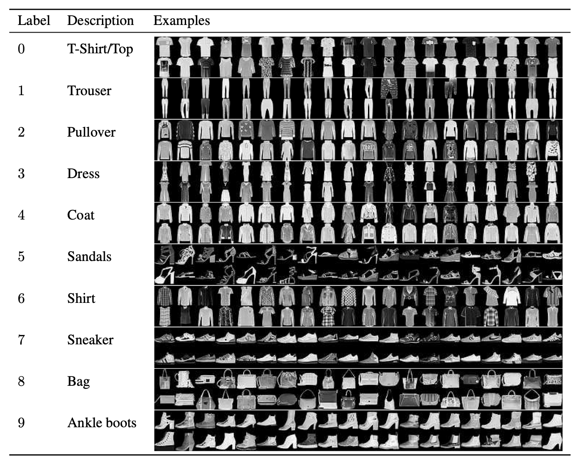
Image Dataset Example: Fashion MNIST
Image taken from Fashion-MNIST: a Novel Image Dataset for Benchmarking Machine Learning Algorithms https://arxiv.org/abs/1708.07747

Slide 35

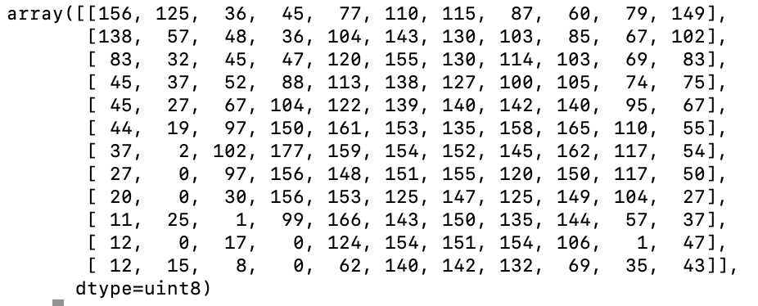
How are Images Processed?
Notes:
Whenever working with image datasets, we standardize the size of the images (in this slide, the image is 12 x 12 pixels). When these images are grayscale, they are converted into 2 dimensional array. Each entry is a value between 0 (which represents black) and 255 (which represents white).
When images are in color, we get an red-green-blue breakdown of each pixel, giving rise to a 3 dimensional array.

Slide 36
Text Data
Text data consists of words, sentences, or paragraphs.
Widely used in natural language processing (NLP) for sentiment analysis, text classification, and more.

Slide 37
Text Dataset Example
Customer | Review Date | Review Text
John Smith | 2023-09-15 | "I had the best burger ever! The fries were fantastic too."
Emily Jones | 2023-09-16 | "The service was excellent, and the atmosphere was cozy."
David Lee | 2023-09-17 | "I was disappointed with the food quality. Won't be returning."
Sarah Davis | 2023-09-18 | "The desserts here are to die for. Highly recommend!"
Lisa Brown | 2023-09-20 | “The prices are high, but the food is worth it.”
Notes:
Here's a fictional example of a text dataset that represents customer reviews for a restaurant. This dataset includes columns for the customer's name, review date, and the text of their review.

Slide 38
Concluding Thoughts
Recognizing the type of data you are working with is crucial in statistical learning.
Different types of data require different statistical techniques and models.
Proper data preprocessing and understanding are fundamental to successful data analysis.

